Slide 1


Exploratory Data Analysis on shopping trends
Name : Muhammed Althaf K
Class : K22UG
REDG NO: 12205672
Roll No : 57

Slide 2
Table of Content
Introduction
Problem Statement
Methodology
Result
Conclusion
References

Slide 3

Introduction
This analysis examines shopping trends by exploring customer demographics, product preferences, and seasonal attributes. The objectives include:
1. Understanding customer preferences and purchase patterns.
2. Evaluating seasonal trends and the impact of discounts on sales

Slide 4
Problem Statement
Retail businesses face challenges in identifying factors influencing customer behavior, spending patterns, and segmentation. This project addresses these challenges by uncovering insights into shopping trends, enabling data-driven strategies.

Slide 5
Methodology
1. Data Collection and Cleaning: Addressed missing values and standardized formats.
2. Analysis: Conducted univariate and multivariate analyses.
3. Visualization: Used tools like Matplotlib and Seaborn to create charts and trends.
4. Insights: Derived actionable findings from trends and patterns.

Slide 6

Results
Key Findings:
- Seasonal preferences: Winter and autumn collections showed higher sales.
- Demographics: Gender and age significantly influenced purchasing patterns.
- Discounts: Promotions increased sales volume significantly.

Slide 7
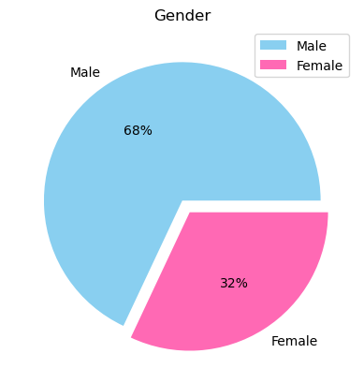
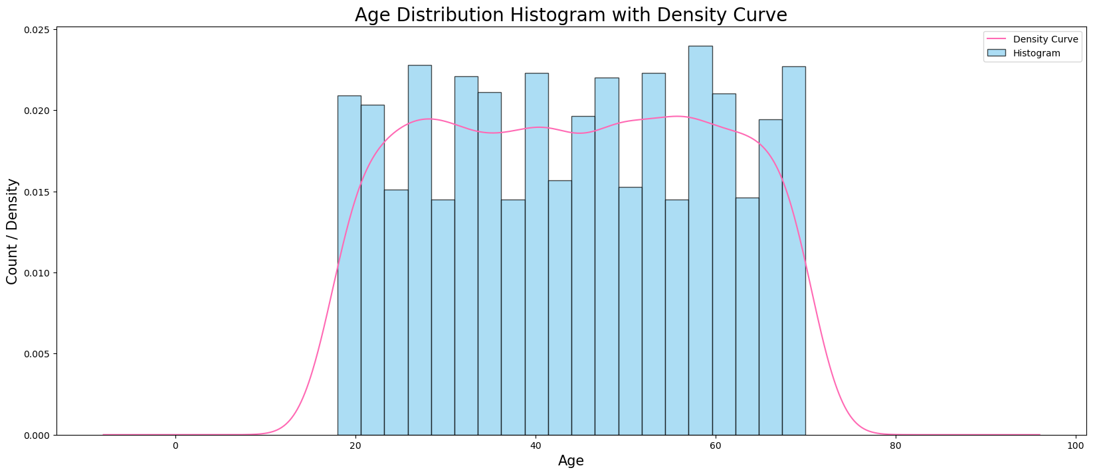
Graphs
Histogram with Density Curve
Pie Chart

Slide 8
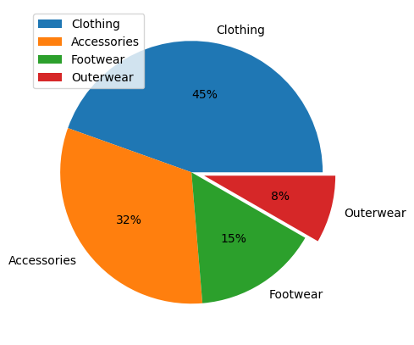
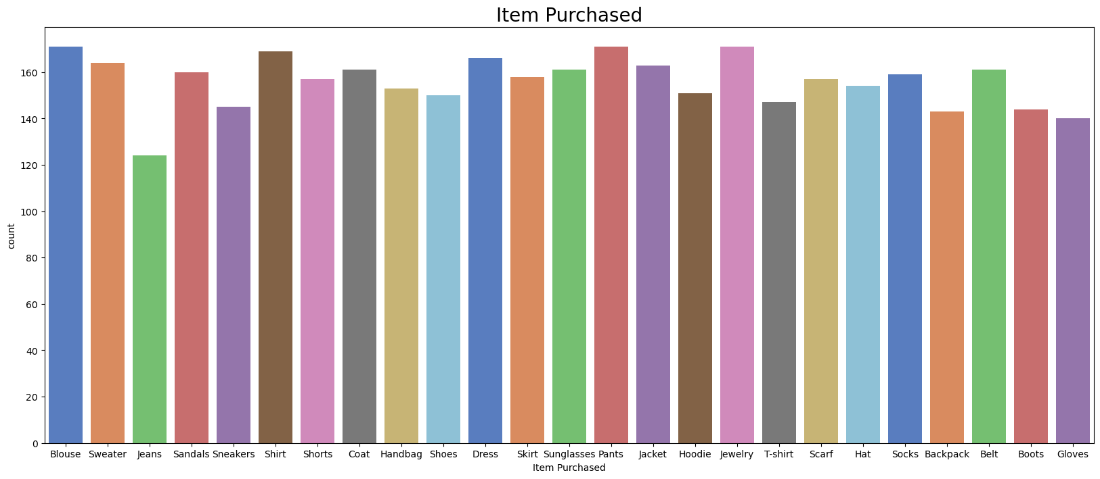
Count-Plot
Pie Chart

Slide 9
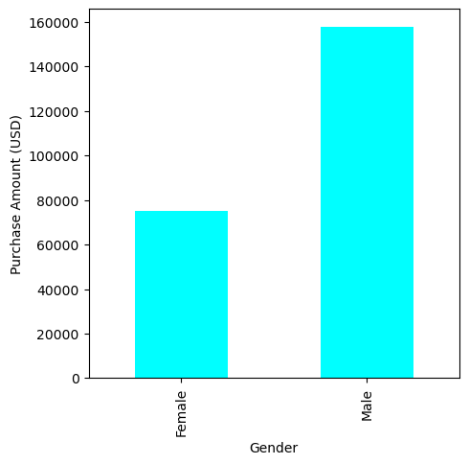
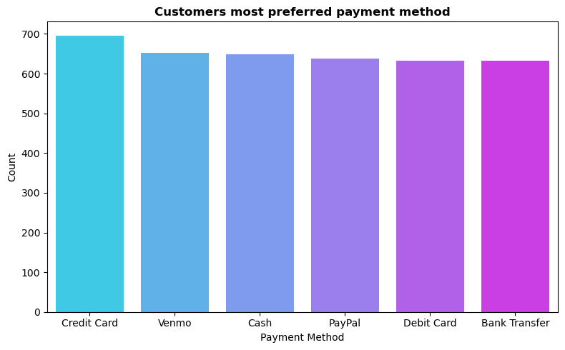
Bar-plot

Slide 10
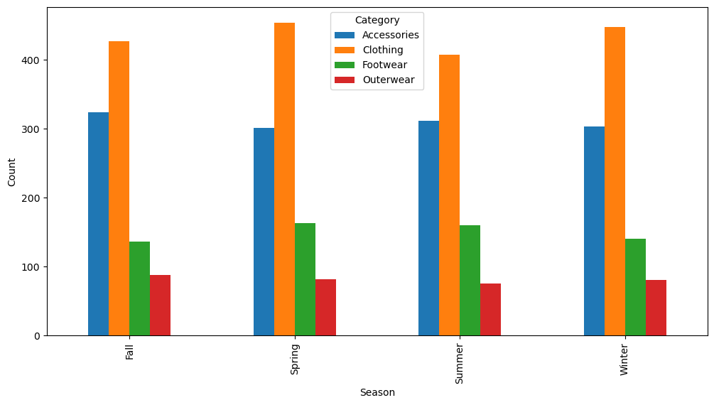
Grouped Bar Graph

Slide 11
conclusion
The analysis reveals insights into seasonal preferences, demographic trends, and the impact of discounts. Businesses can use these insights to optimize inventory, target marketing, and enhance customer satisfaction. Future research can focus on predictive modeling and customer segmentation.

Slide 12
Thank You

